Slide 1
I2C Master Controller

Slide 2
Outline
Introduction
Theory
Methodology
Result
Conclusion

Slide 3
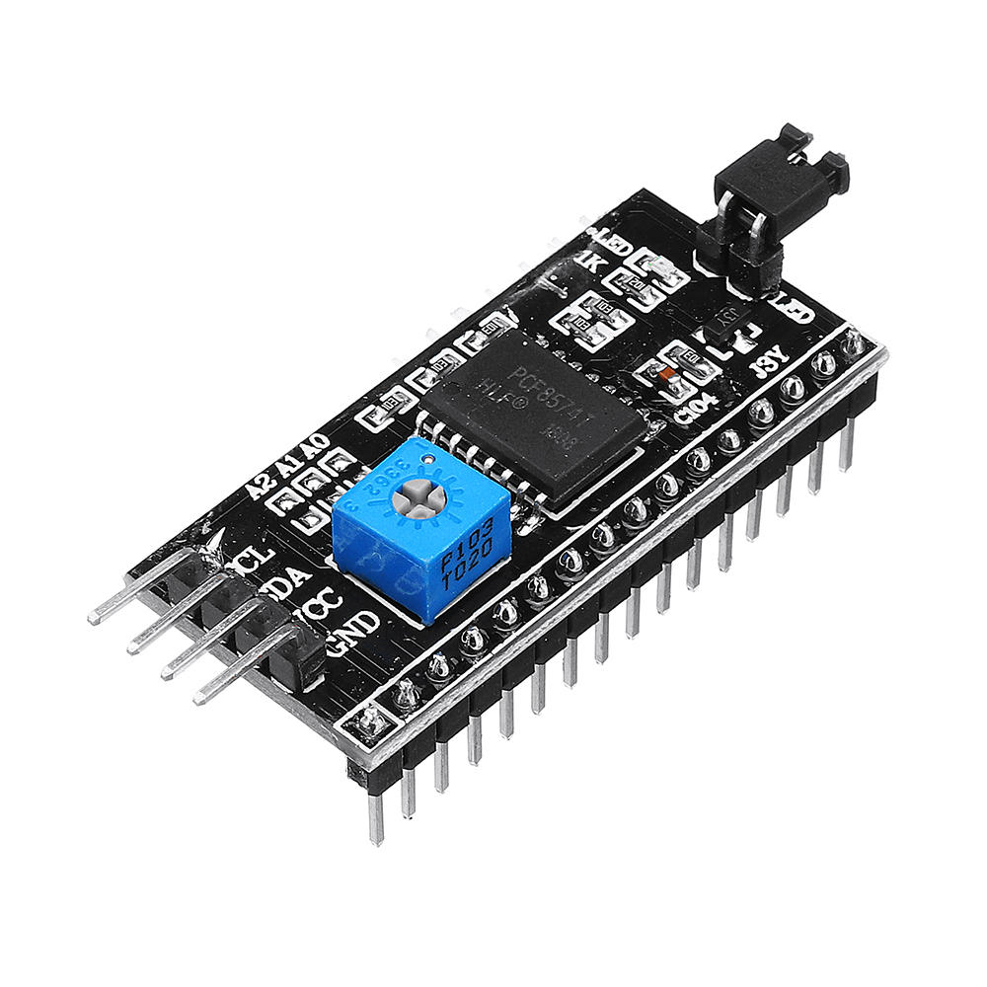
Introduction

Slide 4
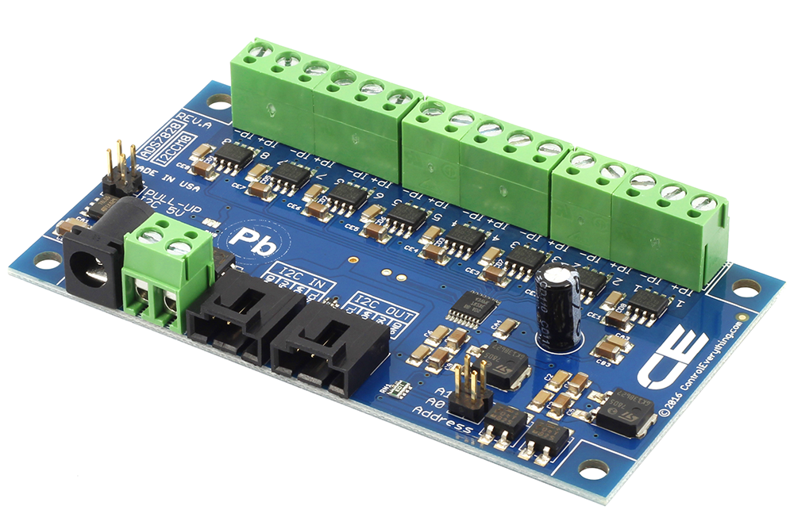
About I2C
Inter-Integrated Circuit (I2C or I²C)
Developed in 1982 by Philips (now NXP)
A very common serial protocol
Used for short distance data communications
Synchronous master – slave protocol
Both master and slaves can send/receive data
Bidirectional, half duplex mode
Can run at different speeds
Two wires: Serial Clock (SCL) and Serial Data (SDA)

Slide 5
About APB Interface
Advanced Peripheral Bus (APB)
Part of Advanced Microcontroller Bus Architecture (AMBA) protocol family.
Non-pipelined
Supports to low-bandwidth peripherals

Slide 6
About LMMI Interface
Lattice Memory Mapped Interface (LMMI)
A simple memory-mapped address/data interface.
Supports both single and burst transactions with a maximum throughput of one transaction per clock cycle.
Supports optional wait states for slave interfaces.

Slide 7
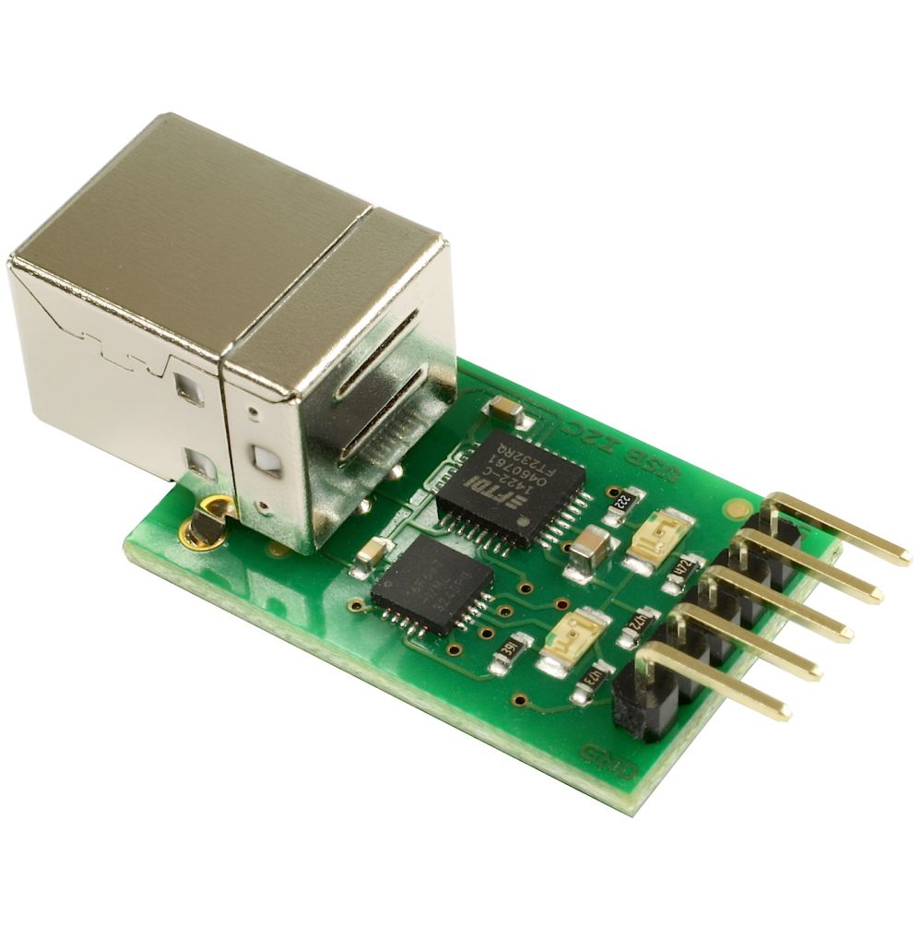
Theory

Slide 8
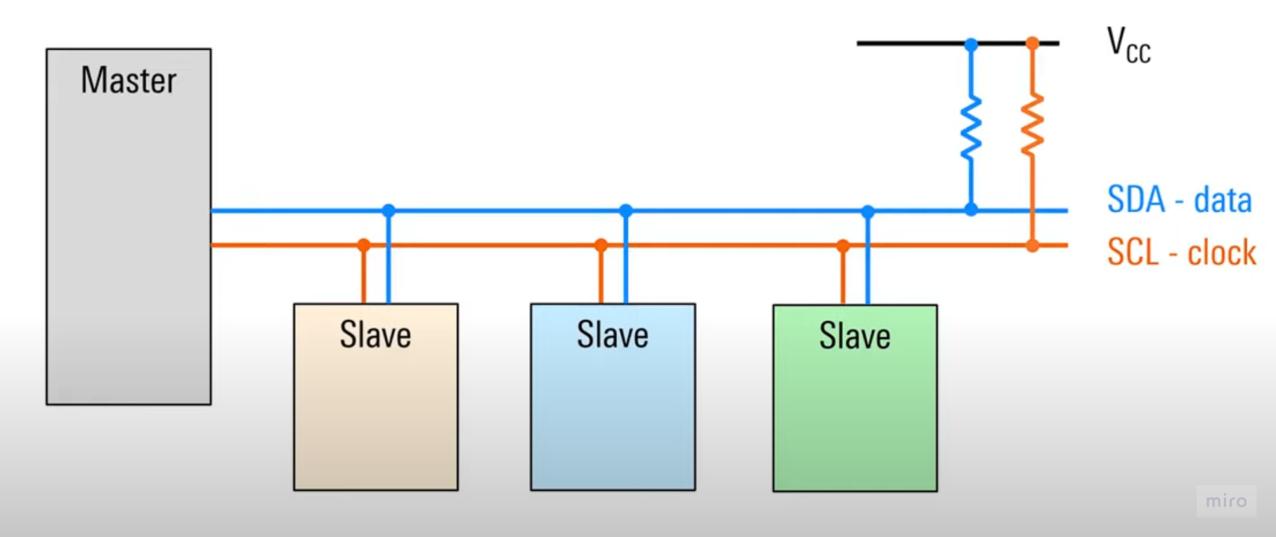
Basic Topology
One master (or many) connected to one slave (or many) via two lines – SDA and SCL.
Each line connects to a voltage VCC or VDD by a single pull-up register.

Slide 9
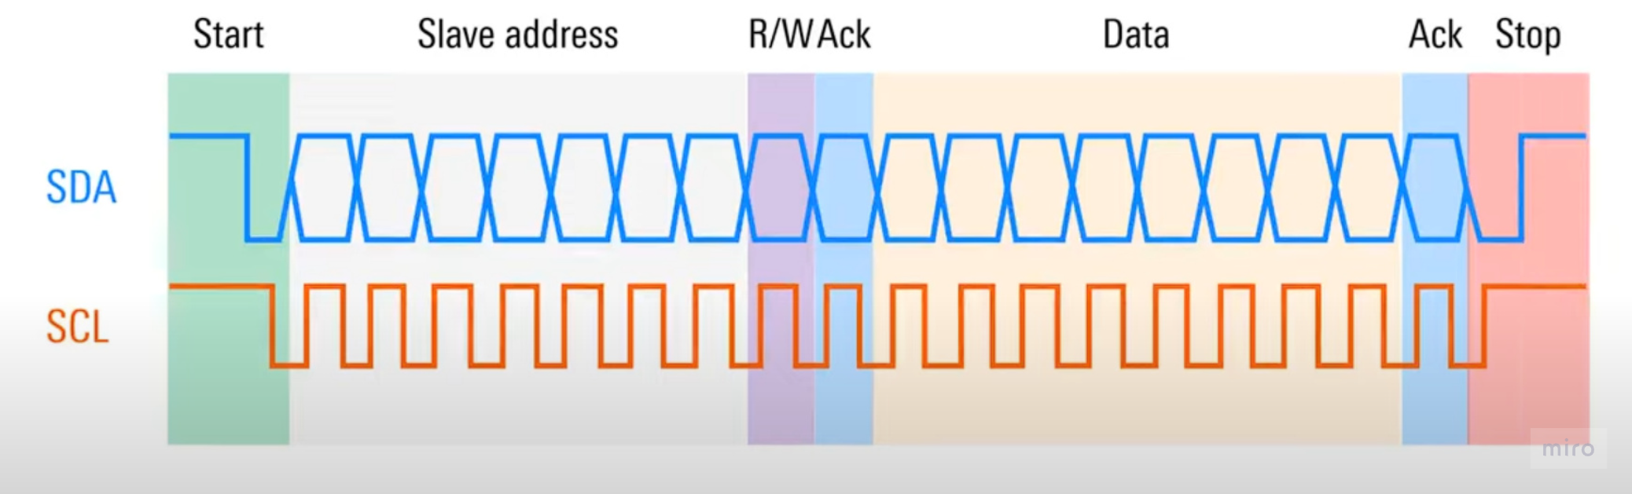
Frames
Master claims the bus by a “Start” condition.
Then it sends the address to the slave, followed by a “Read-Write” bit.
Slave acknowledges the bus and send back the “ACK” bit.
Master sends the data byte to the slave and receive the “ACK” bit one more time.
The communication is terminated by “Stop” condition.

Slide 10
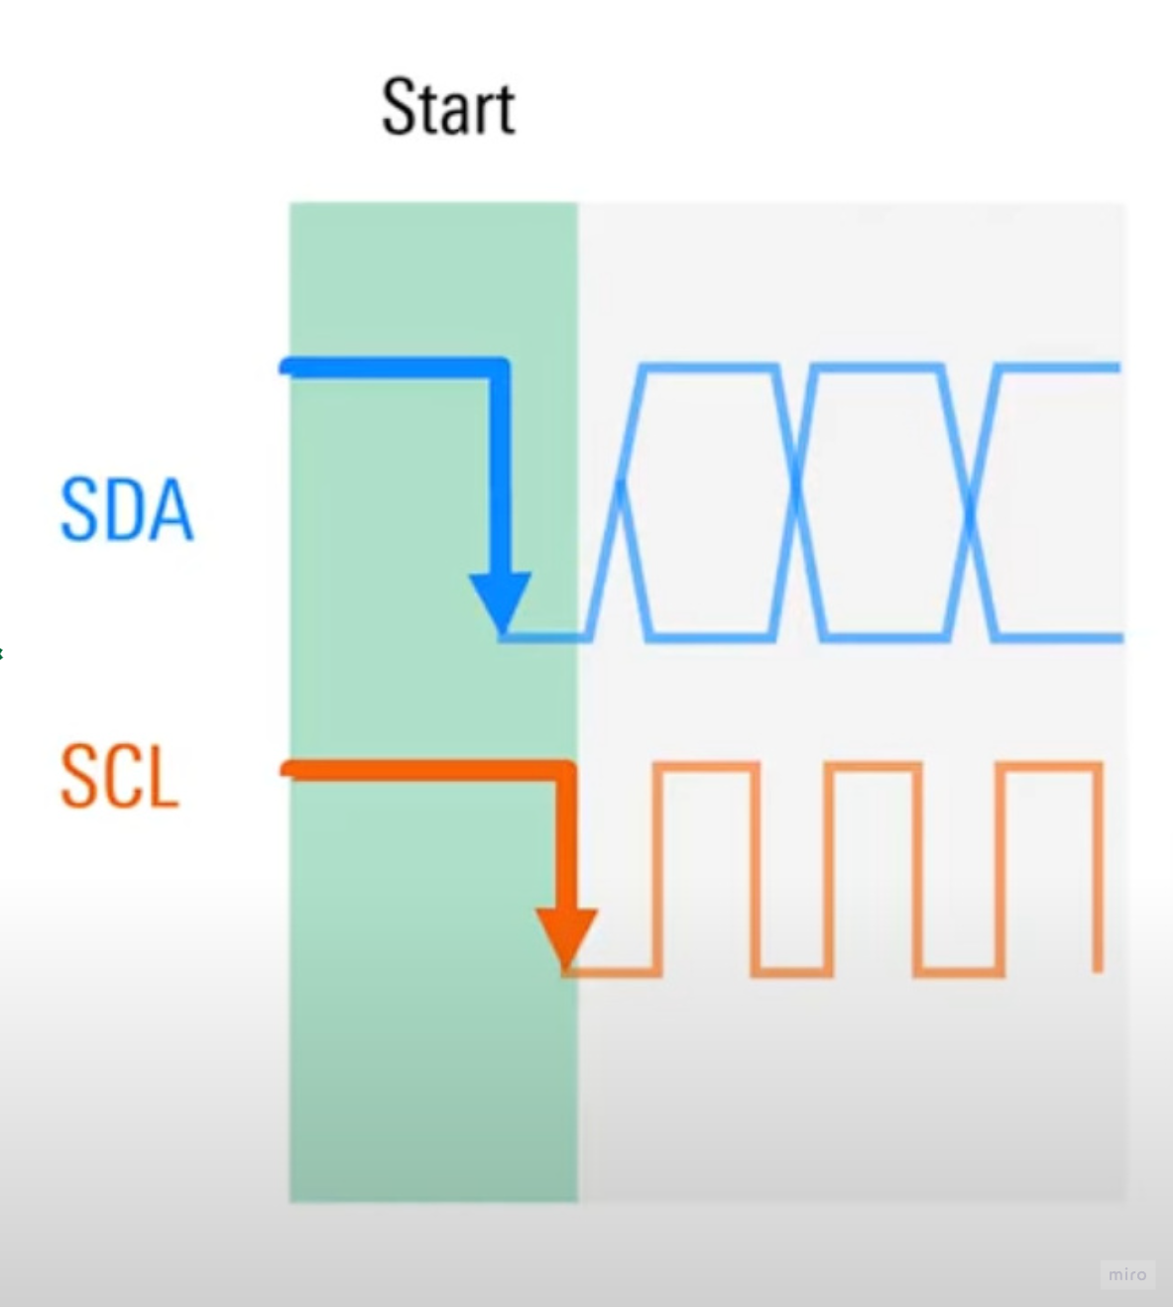
Start condition
Both lines are asserted.
“Start” condition occurs when a node first pulls SDA line LOW, then pulls SCL line LOW.
Prevents any other nodes taking control of the bus.
Master starts the clock signal when a bus is claimed.

Slide 11
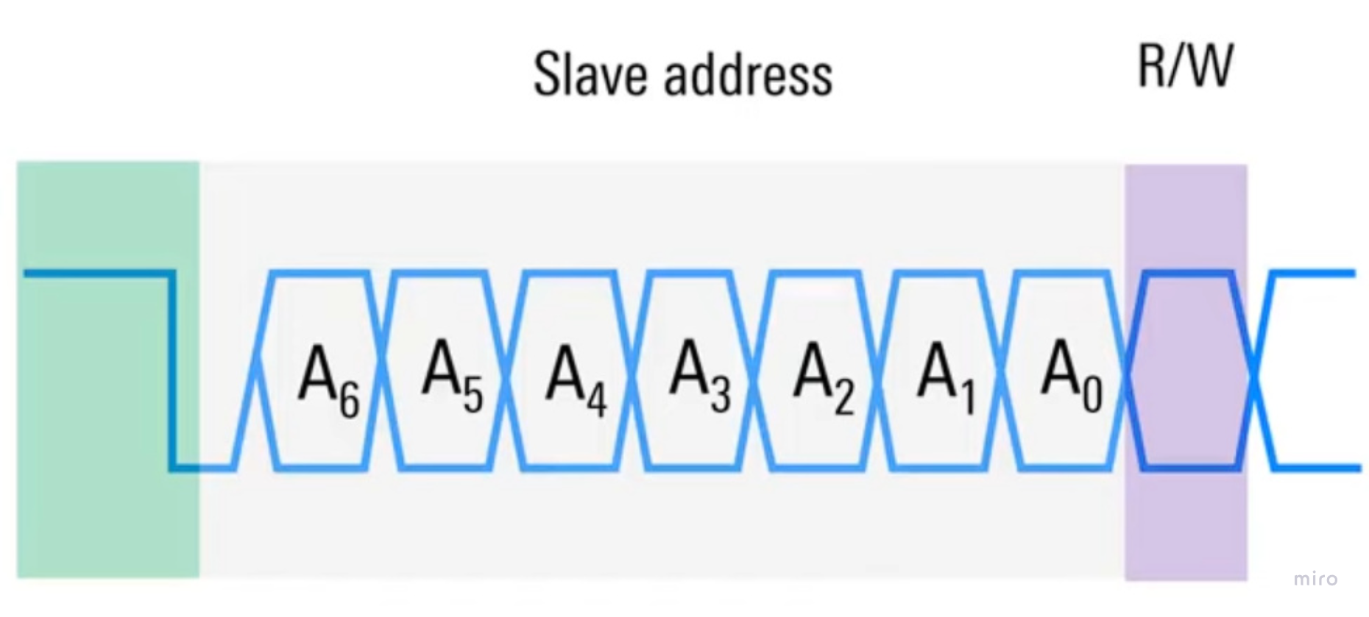
Sending address and R/W bit
Master sends a 7-bit address to the slave.
The address (unique and fixed) specifies the node master wants to communicate with.
The Read/Write (R/W) bit let slave knows which function is operated (0 - READ and 1 - WRITE).
The R/W bit is decoded with address to form an address byte.

Slide 12
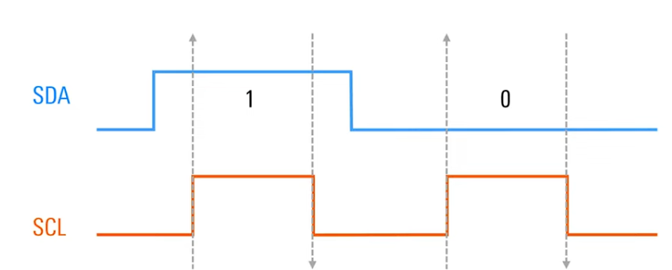
Timing relationship
SDA does not change value between rising or falling edge of the SCL.
SDA only transfers data when SCL is LOW to avoid “Start” or “Stop” condition.

Slide 13
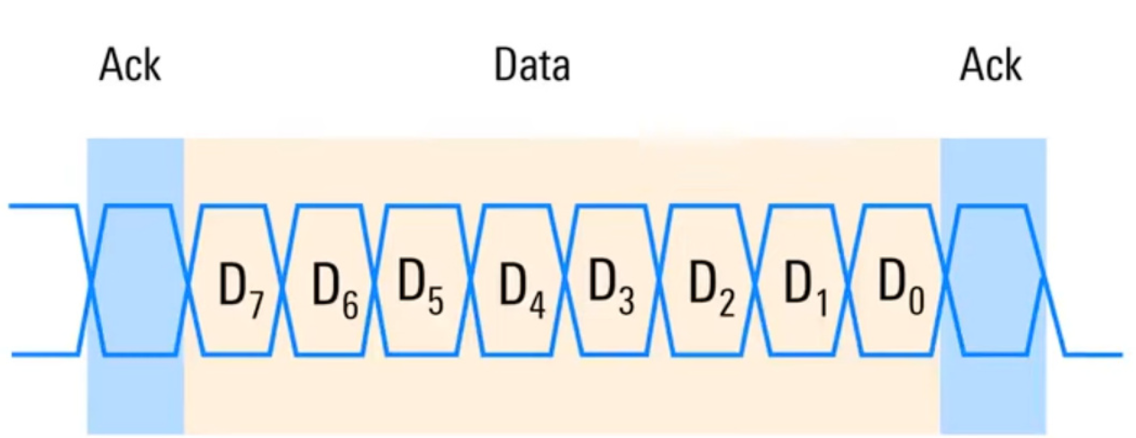
Sending data
“ACK” bit is sent by the slave, 0 is acknowledged and 1 is negative ack (NACK).
ACK bit is used to confirm the readiness of address or data.
8-bit data byte contains the transferred information (memory, addresses or register contents).

Slide 14
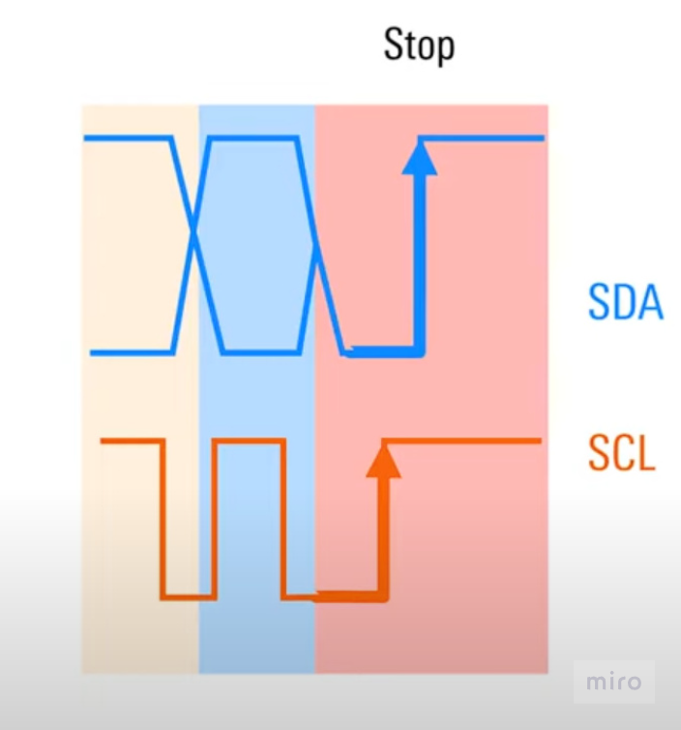
Stop condition
Indicating the end of communication.
First SCL is asserted and remains HIGH, then SDA also do the same.
The bus will become idle, there is no clock signal and now any node can use “Start” condition to claim the bus.

Slide 15
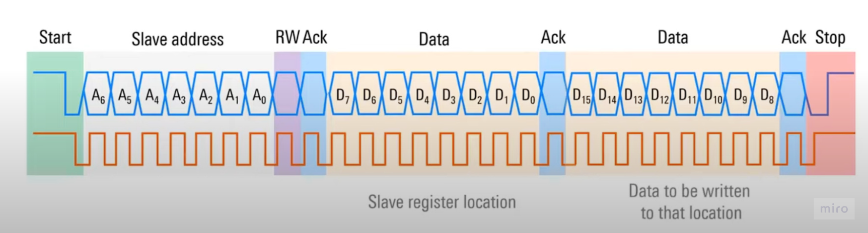
Sending multiple data bytes
Additional data bytes with ACK bit concatenate onto previous byte.
The data bytes can be all data or different types of variables.

Slide 16
Methodology

Slide 17
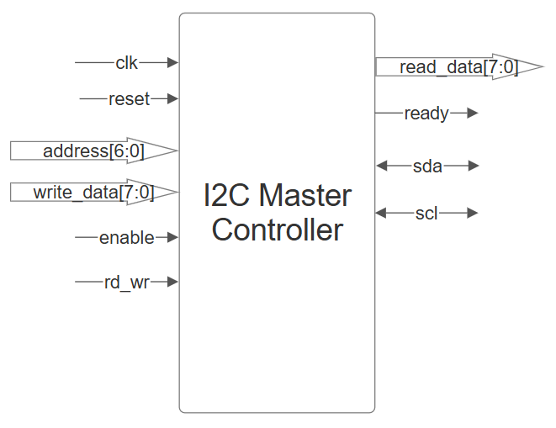
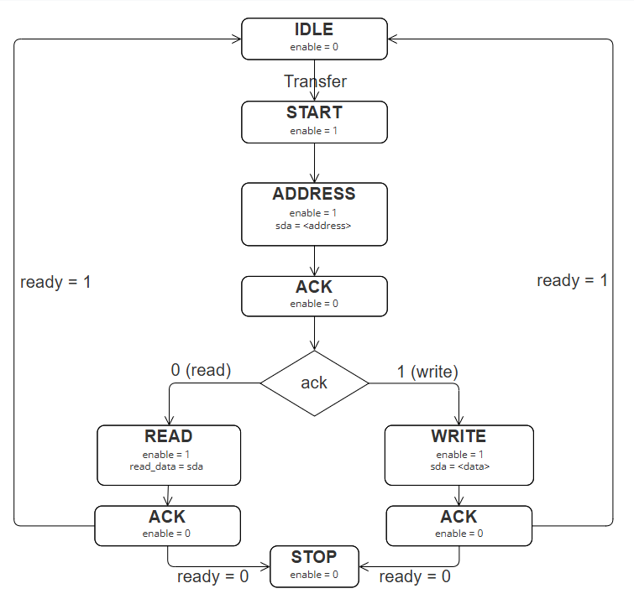
1. I2C Master Controller
Block Diagram
Final State Machine

Slide 18
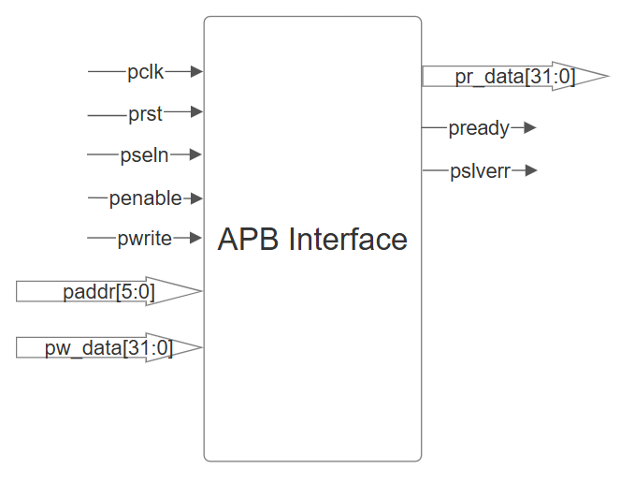
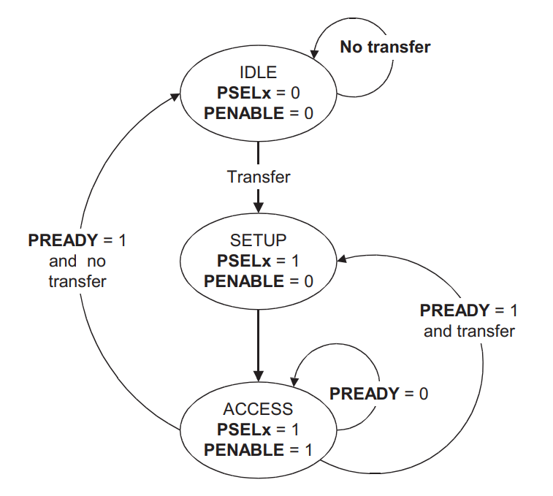
2. APB Interface
Block Diagram
Final State Machine

Slide 19
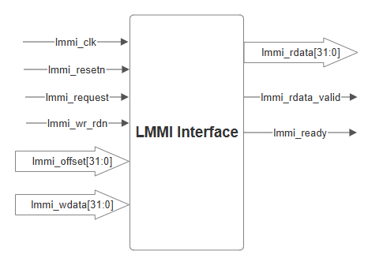
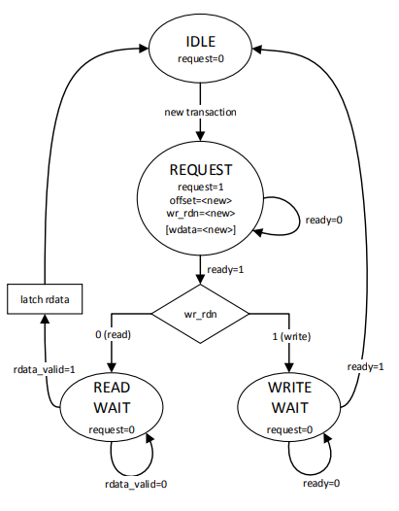
3. LMMI Interface
Block Diagram
Final State Machine

Slide 20
Results

Slide 21
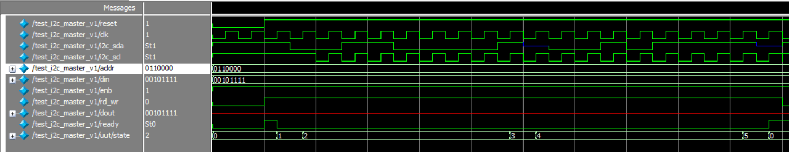
I2C Master Controller - WRITE Transaction

Slide 22
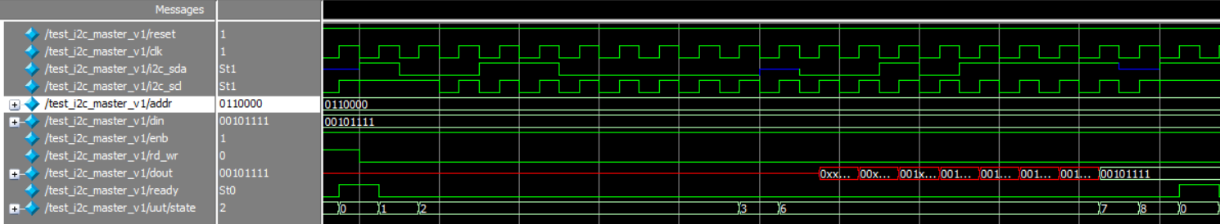

I2C Master Controller - READ Transaction

Slide 23
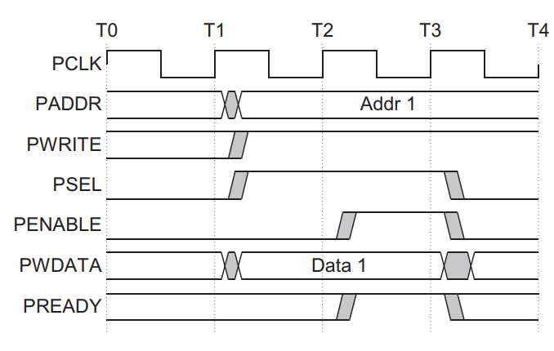
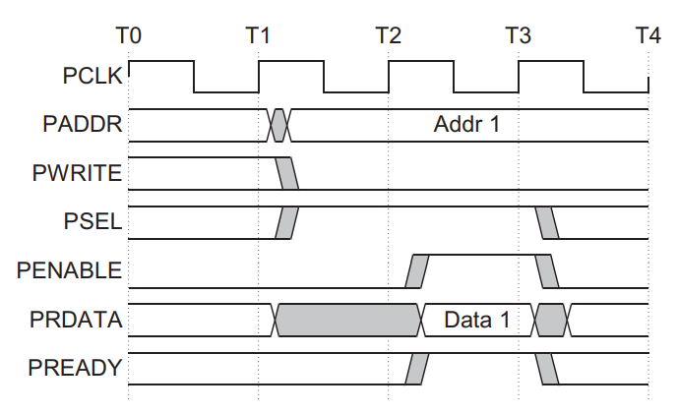
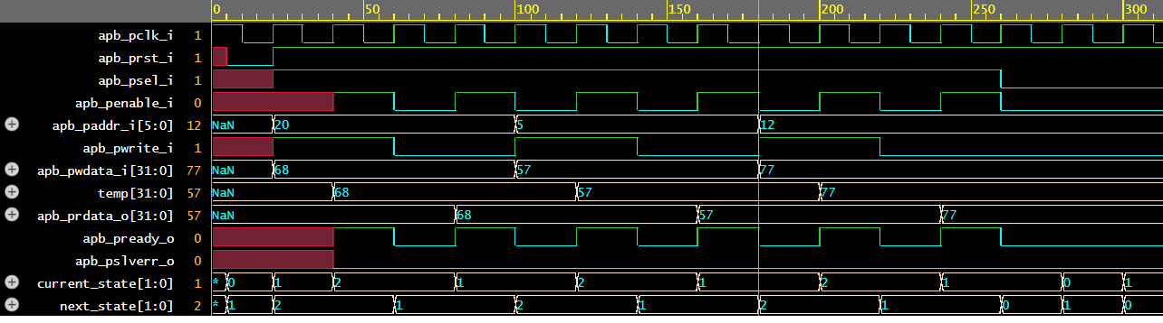
APB Interface - WRITE and READ with no wait states

Slide 24
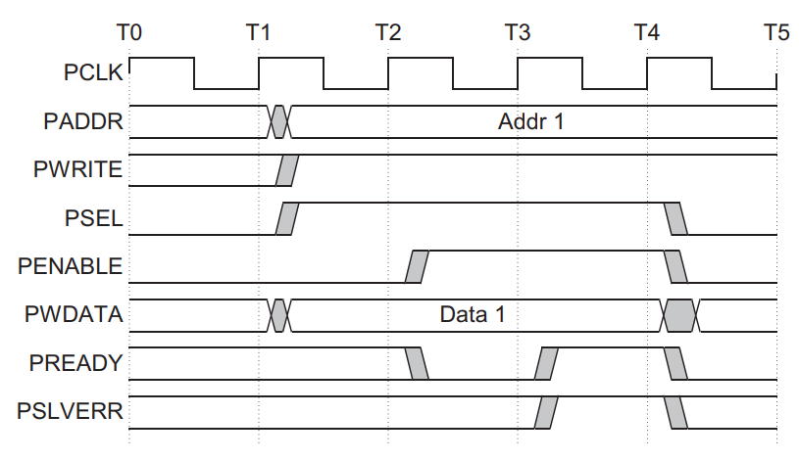
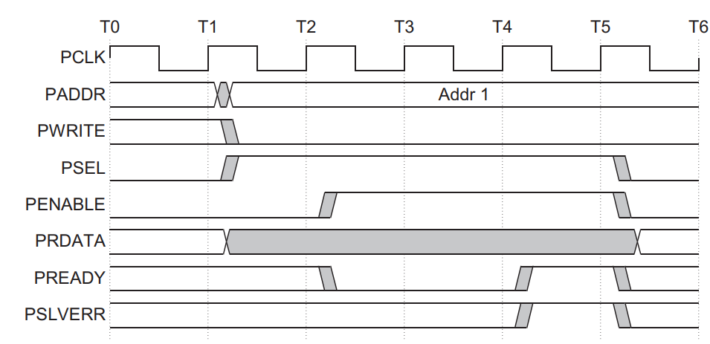
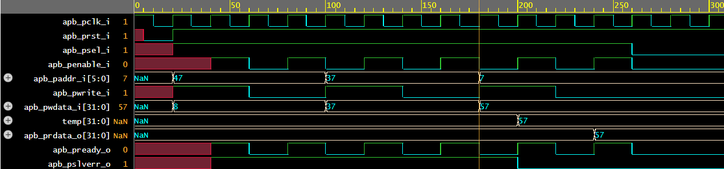
APB Interface - WRITE and READ with no wait states (failing)

Slide 25
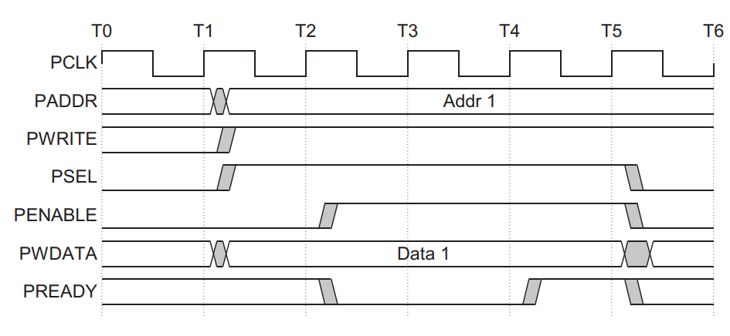
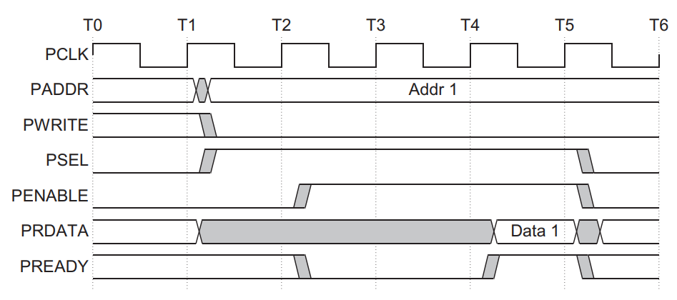
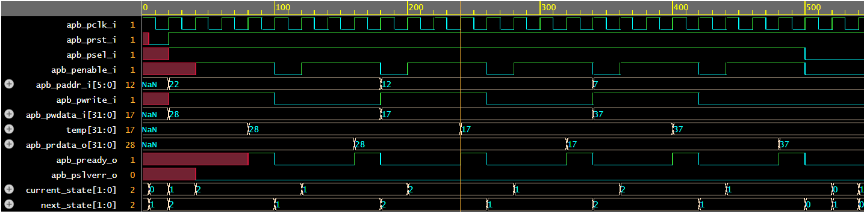
APB Interface - WRITE and READ with wait states

Slide 26
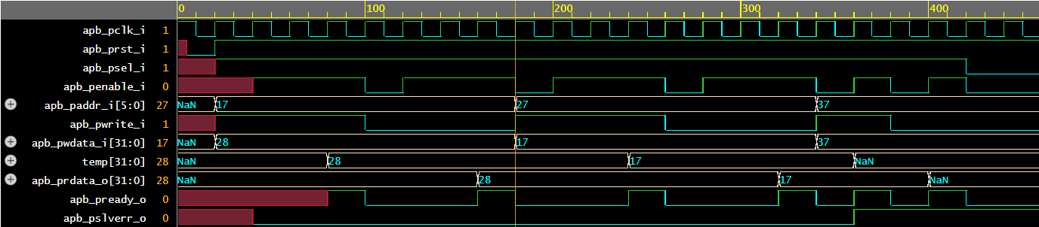
APB Interface - WRITE and READ with wait states (failing)

Slide 27
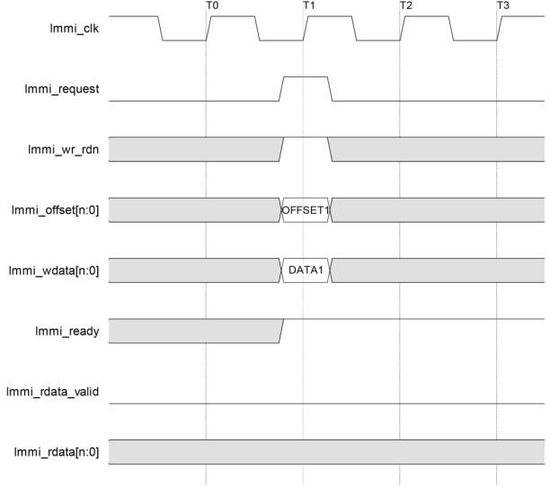
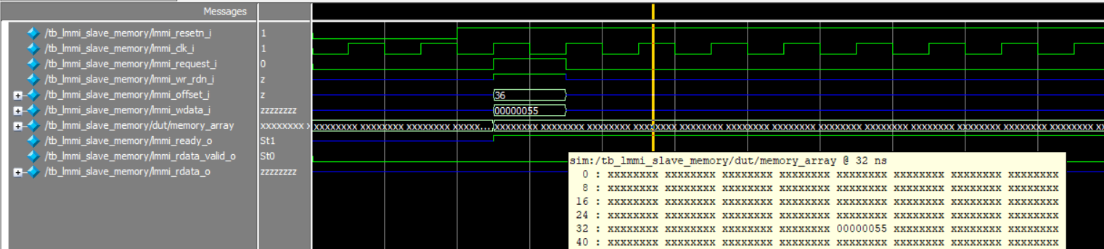

LMMI Interface – Single WRITE with no wait states

Slide 28
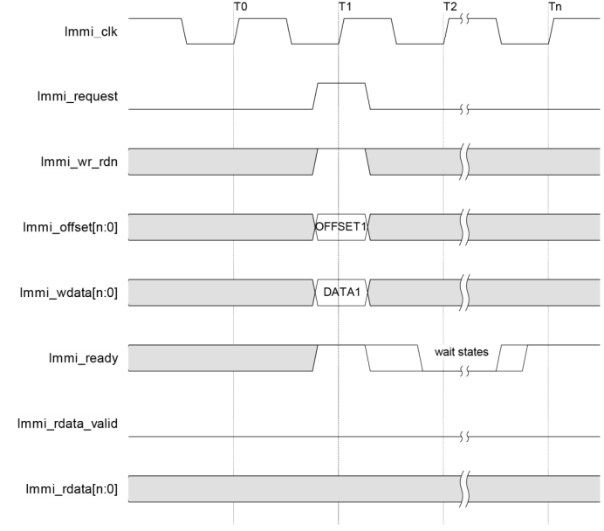
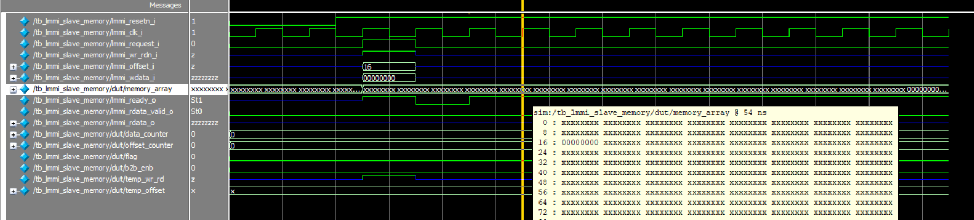

LMMI Interface – Single WRITE with wait states

Slide 29
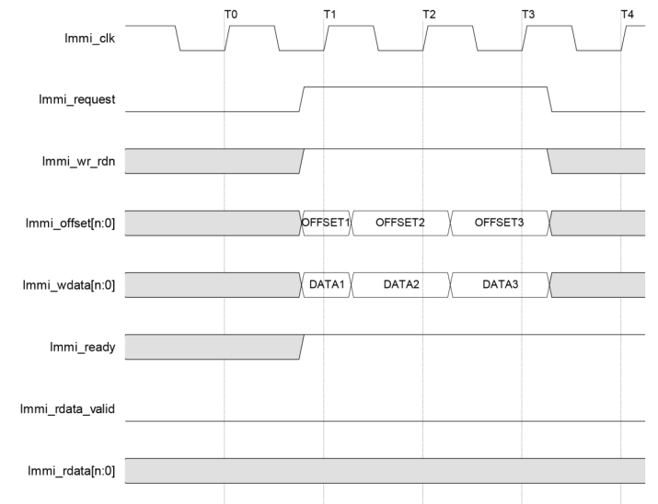
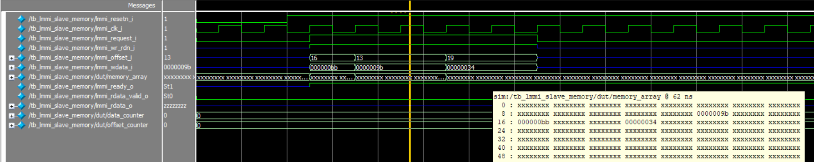



LMMI Interface – Burst WRITE with no wait states

Slide 30
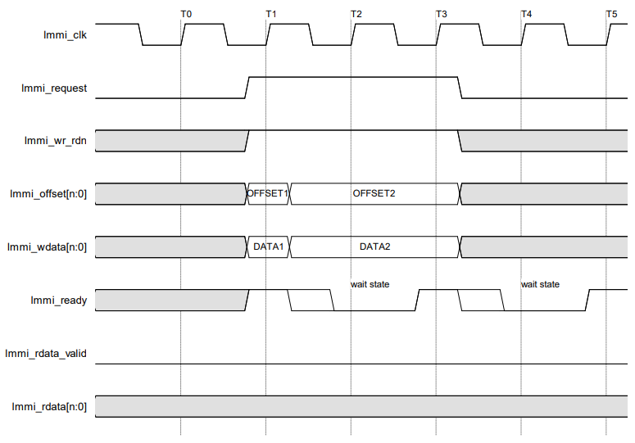
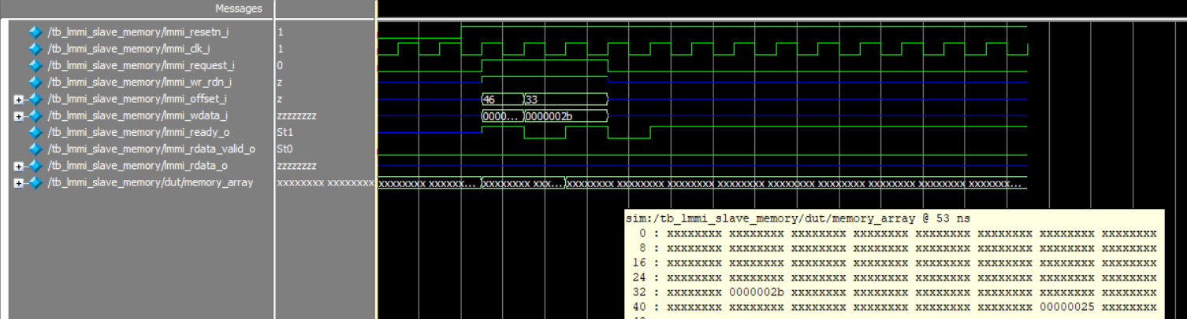


LMMI Interface – Burst WRITE with wait states

Slide 31
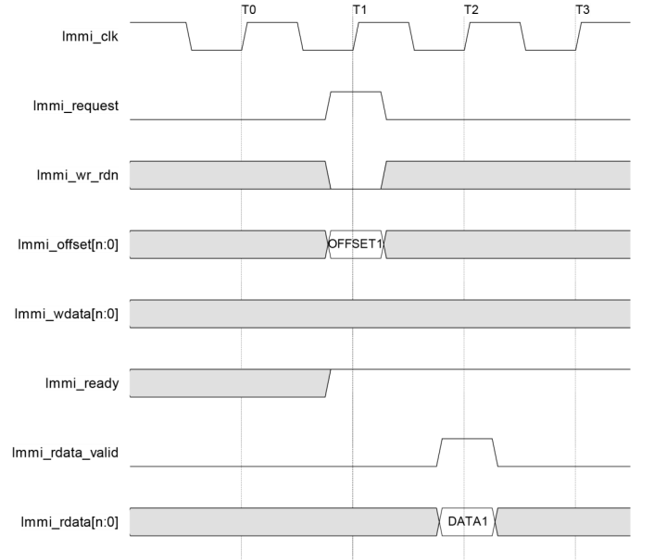
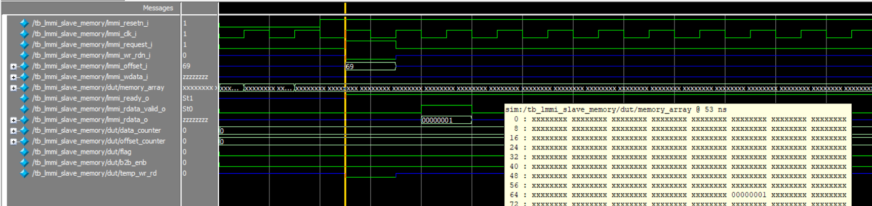

LMMI Interface – Single READ with no wait states

Slide 32
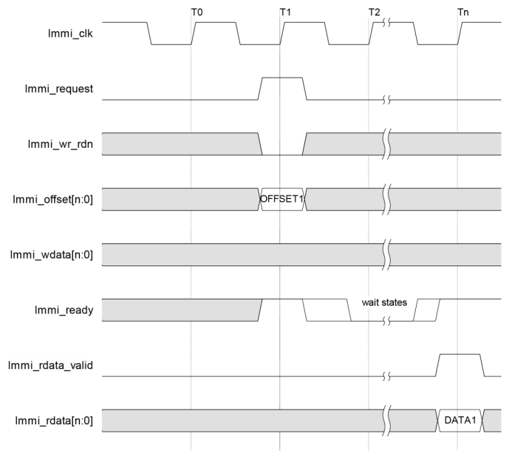
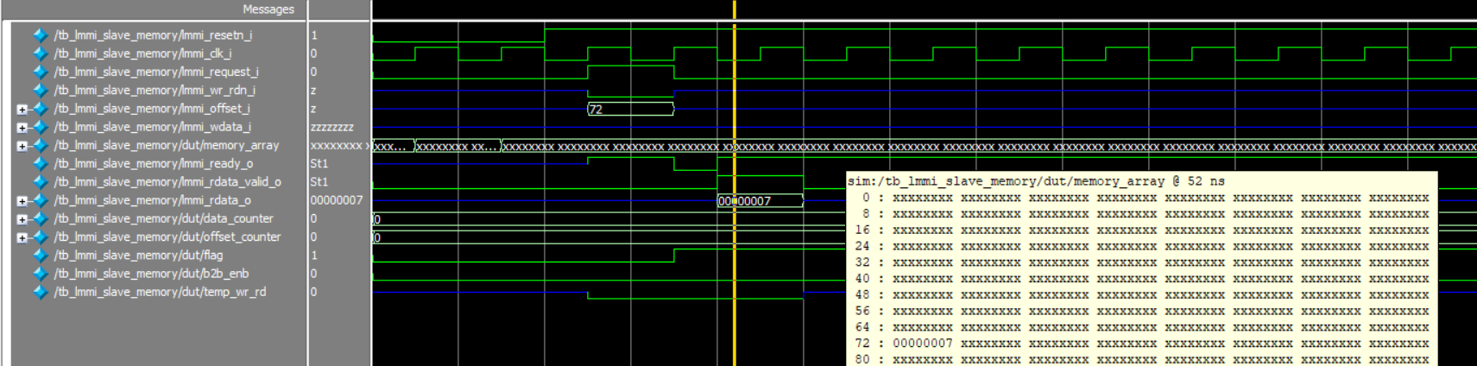

LMMI Interface – Single READ with wait states

Slide 33
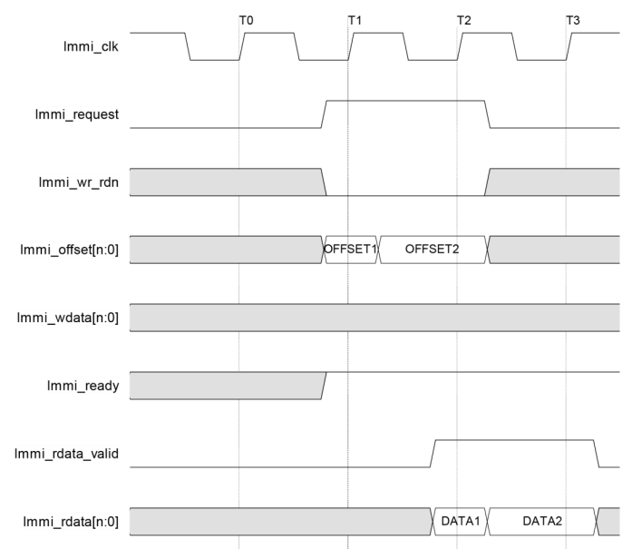
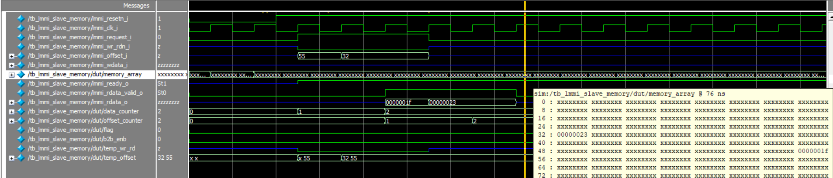


LMMI Interface – Burst READ with no wait states

Slide 34
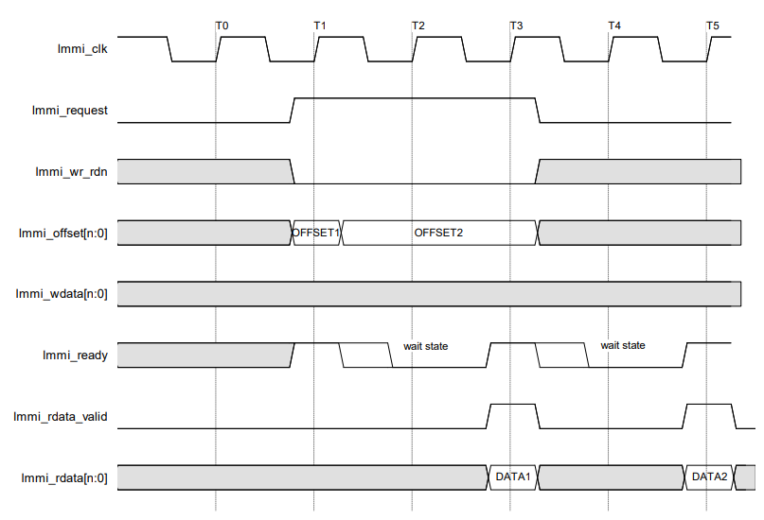
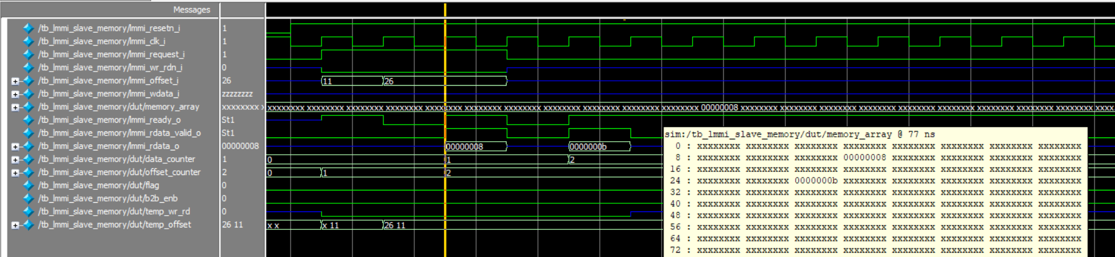


LMMI Interface – Burst READ with wait states

Slide 35
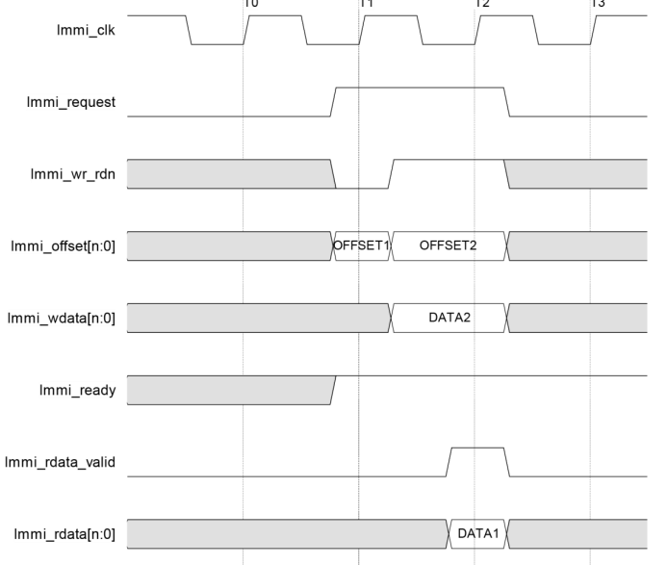
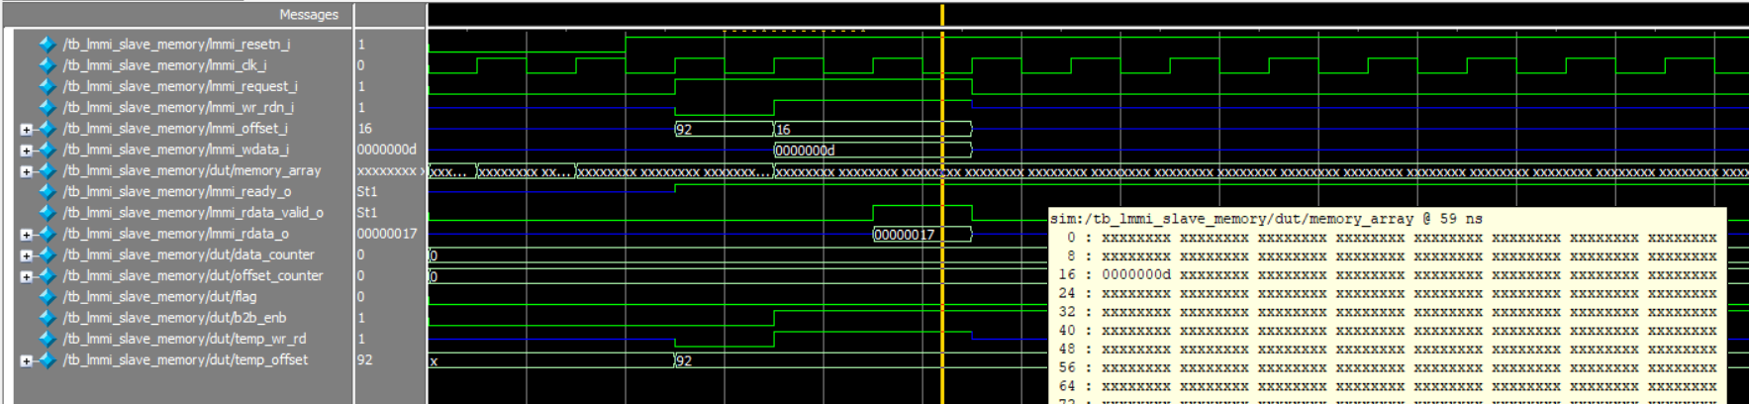

LMMI Interface – Back-to-Back READ and WRITE with no wait states

Slide 36
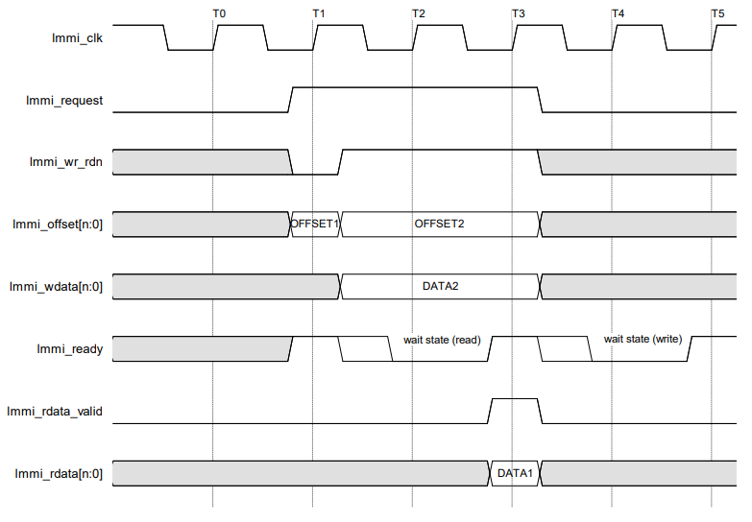
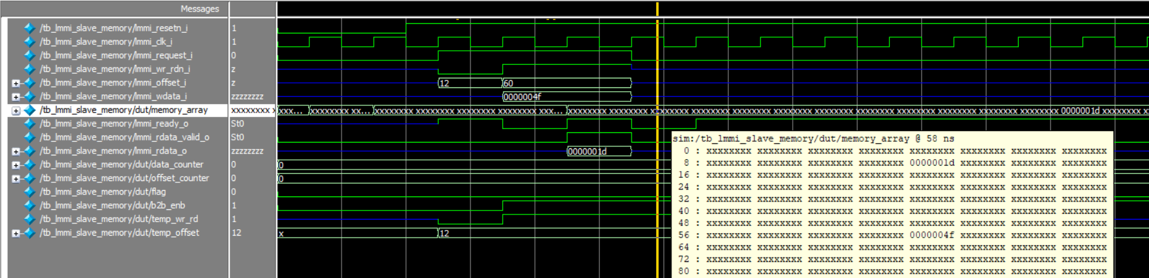

LMMI Interface – Back-to-Back READ and WRITE with wait states

Slide 37
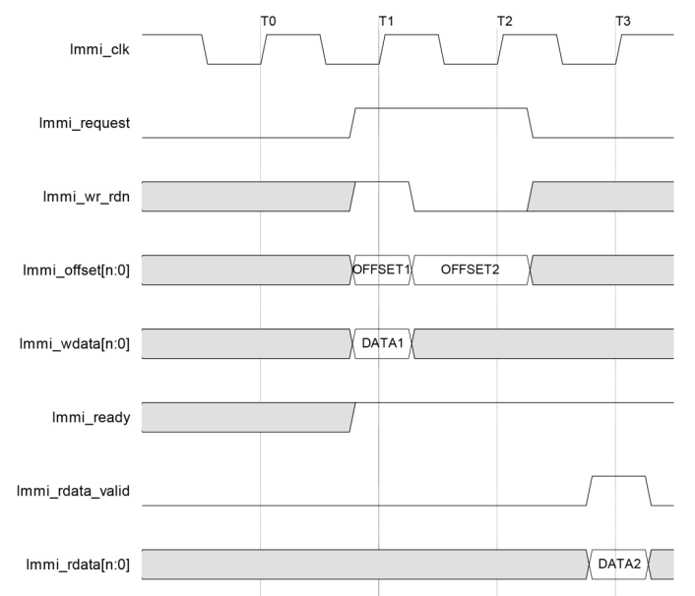



LMMI Interface – Back-to-Back WRITE and READ with no wait states

Slide 38




LMMI Interface – Back-to-Back WRITE and READ with wait states

Slide 39
Conclusion

Slide 40
Success and Shortcoming
SUCCESS | SHORTCOMING
Design protocol of I2C Master Controller and two interfaces (APB, LMMI). Write testbench and verify all testcases for each module. | Write top module connect three modules. Maximize the flexibility of inputs to control the outputs independently.

Slide 41
Thank you

